Slide 1


Correlation Between Weather Conditions and Production Metric Yield in Rendering Plant
Surena Nokham
DSC 680-T301:
Applied Data Science
June 2024

Slide 2

Background
Analysis of correlation between weather conditions & operation metrics in rendering plants
Importance
Enhances operational decision-making
Addresses customer complaints with evidence-based explanations

Slide 3
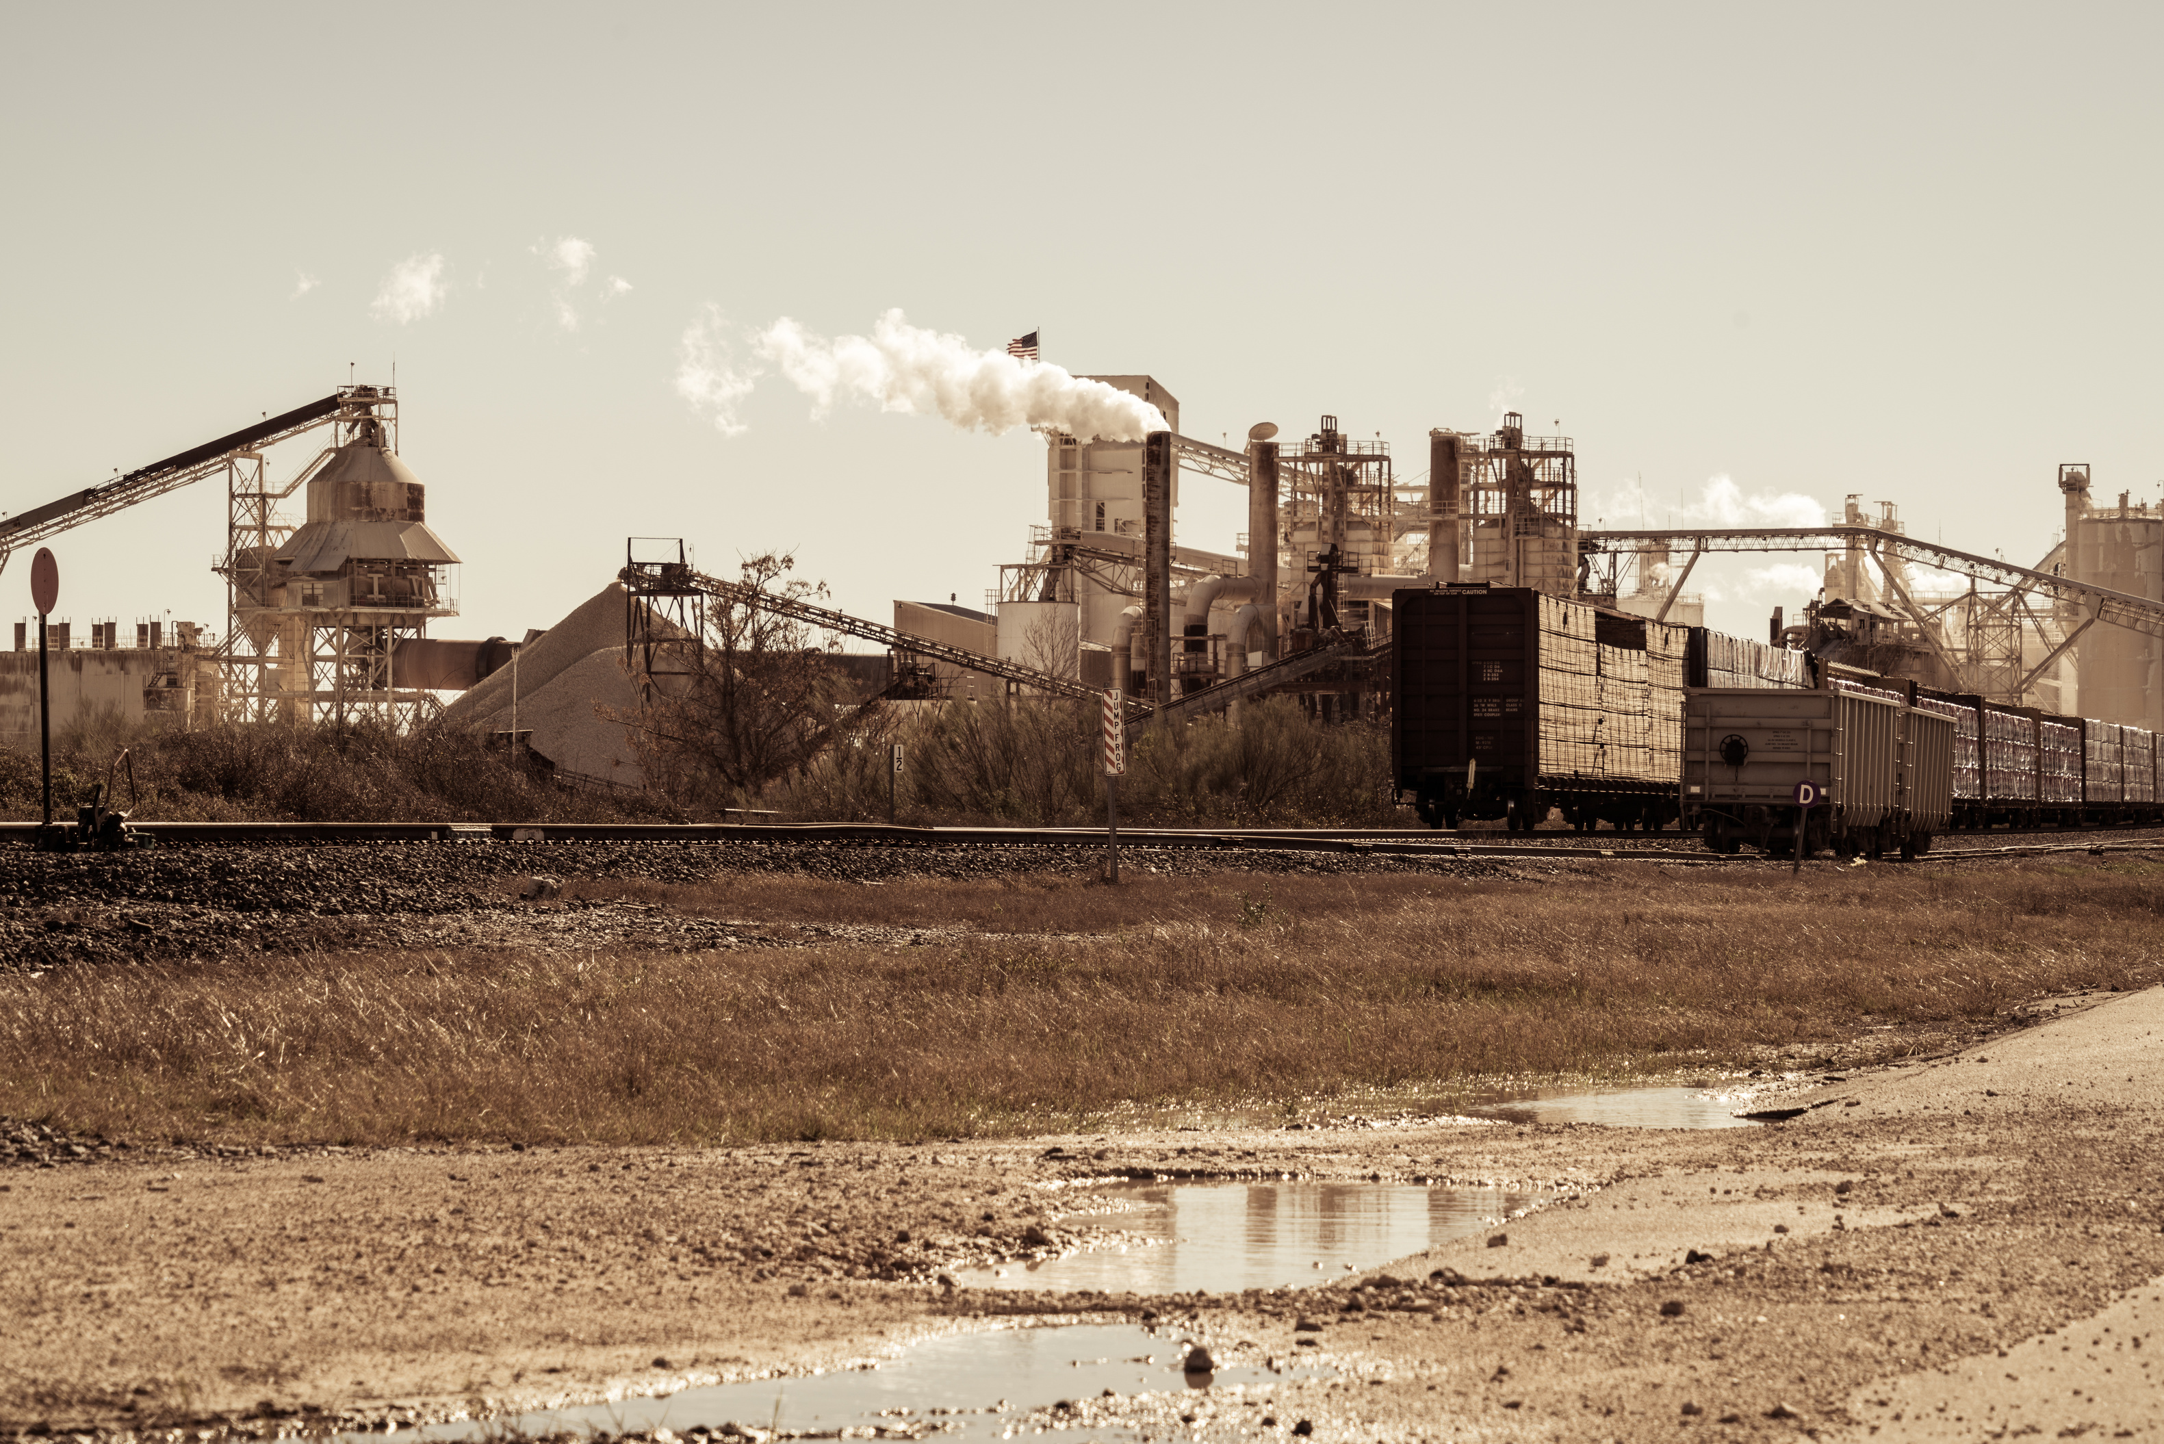
Data Sources
Data Preparation
LIMS Labware Data
SAP Production Data
NOAA Weather Data
Convert date columns
Filter to common date range
Merged datasets
Handled missing values

Slide 4
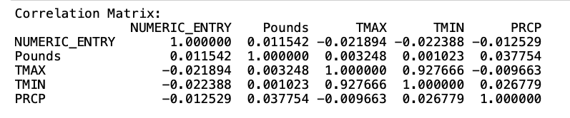
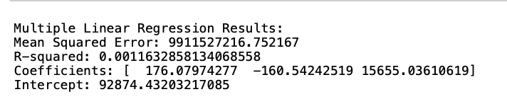
Methods
Exploratory Data Analysis (EDA): Initial analysis performed
Correlation Analysis: Identifying relationships
Regression Analysis: Predictive modeling

Slide 5

Exploratory Data Analysis (EDA)
Weak correlation between weather impact and customer complaints
Weak correlations between production lbs & weather variables
Slight negative correlation between analysis values and temp

Slide 6


Regression Analysis
Linear Regression: MSE = 9911527216.75, R-squared = .00116
Ridge Regression: MSE = 9856138778.24, R-squared = .00674
Lasso Regression: MSE = 9886206723.11, R-squared = .00371
Insights:
weather variables have minimal impact on production pounds
Cross-validation scores suggest poor model generalizability

Slide 7
Results & Interpretation
Weather conditions (temp & precip) show weak correlations to production metrics
Other factors might be influencing variability
Further investigation needed to explain yield and complaints
Limited time range of data

Slide 8

Ethical Considerations
Data Privacy and Handling
Avoiding Biased Conclusions

Slide 9
Q&A
1. What specific weather conditions have the most significant impact on yield?
Answer: Higher precipitation significantly increases yield.
2. How were missing data handled in the analysis?
Answer: Missing data were excluded to ensure accuracy.
3. Can the findings be generalized to other rendering plants?
Answer: Insights can guide other plants but require broader studies for generalization.
4. What are the practical steps to mitigate the impact of adverse weather conditions?
Answer: Monitor forecasts, adjust schedules, improve infrastructure, and train staff.
5. How reliable are the predictive models developed in this study?
Answer: Models have low R-squared values, indicating limited reliability.
6. What role does equipment maintenance play in the correlation observed?
Answer: Crucial for operational efficiency and mitigating weather impact.
7. How frequently should data be updated for monitoring purposes?
Answer: Continuously or daily for real-time decision-making.
8. Are there any weather conditions that positively impact yield?
Answer: Higher precipitation positively impacts yield.
9. How were ethical considerations addressed in the study?
Answer: Data was anonymized, analyses were unbiased, and data accuracy ensured.
10. What additional data could improve the accuracy of the analysis?
Answer: Detailed operational data, geographical info, more weather variables, and human factors.

